Slide 1
Adversarial Attack on Graph Structured Data
Dai et. al (ICML 2018)
Presented by
Aravind Sankar

Slide 2
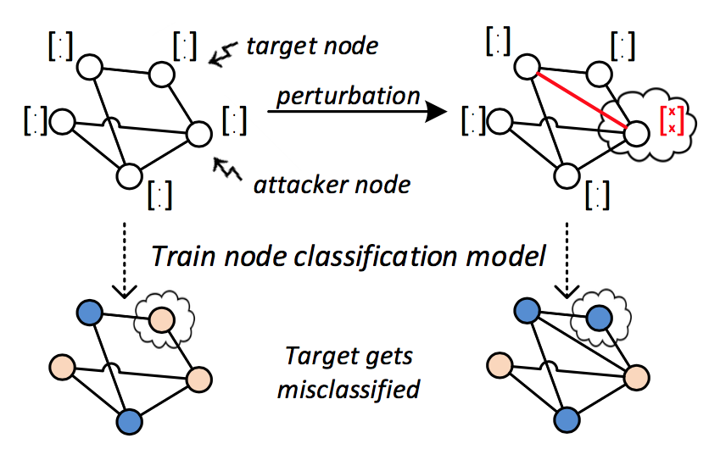
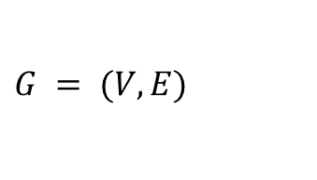


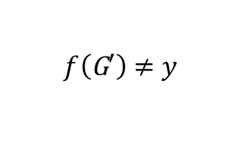
Problem setting
Graph Classification
Semi-supervised node classification
perturbation
perturbation
$$G = (V,E)$$
$$G′=(V,E′)$$
$$f(G)=y$$
fool the classifier
$$f\left(\text{G}′\right)≠y$$
Notes:
This paper considers two different problem settings – (1) semi-supervised node classification in a large graph where the goal is to classify nodes in the graph into K classes given a limited number of labeled examples. A typically setting is classifying research papers in citation networks.
(2) Graph classification – where the goal is classify a collection of small graphs into different categories. A common setting is classifying small molecules such as proteins. Etc.

Slide 3
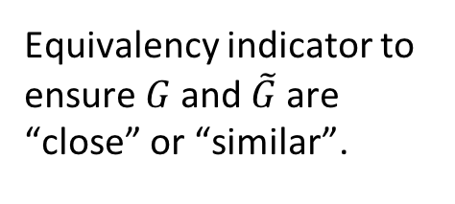
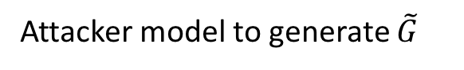
How is it different from existing adversarial attacks?
Image data is continuous but graphs are discrete.
Text data is sequential but graphs have combinatorial structures.
Attacker Model:
Evasion attack:
Attacker g is allowed to add or remove edges at test time.
Adversarial Loss
Attacker model to generate $\tilde{G}$
Equivalency indicator to ensure $G$ and $\tilde{G}$are “close” or “similar”.
Notes:
Inductive vs transductive learning scenarios. Graph classification inductive while node classification is typically inductive.
Attack is targeted -> in the sense that the goal is to attack a particular node rather than the overall model performance.
Instead of say images where targeted attacks focus on classifying to a particular class.

Slide 4
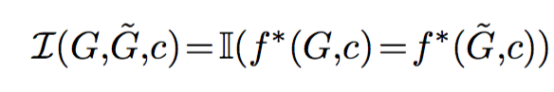
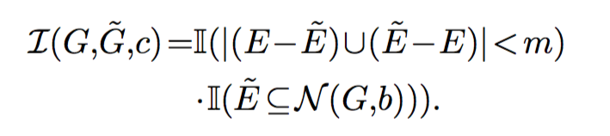
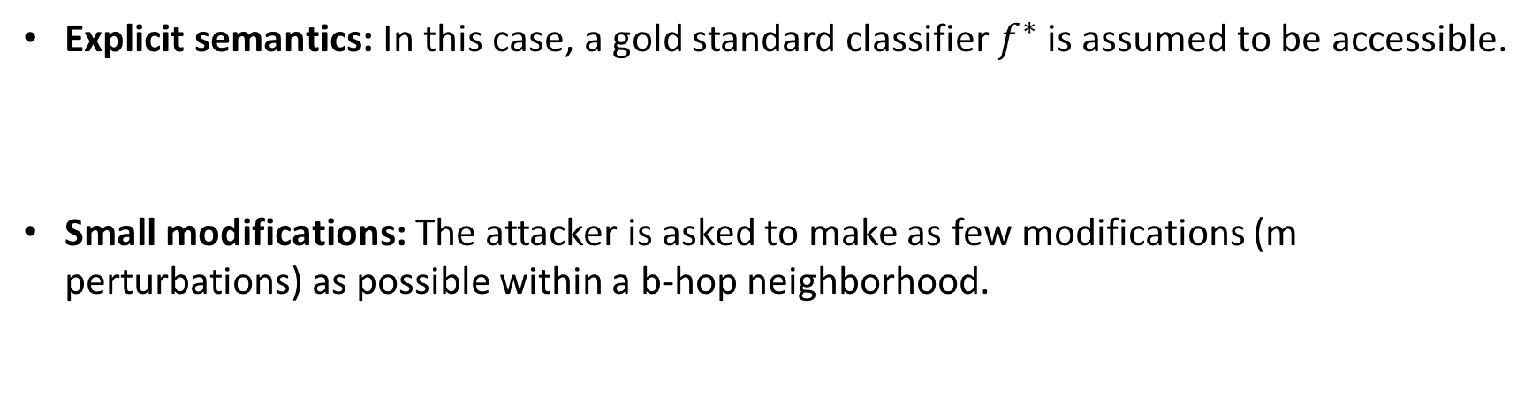
Equivalence Indicator
Explicit semantics: In this case, a gold standard classifier $f^{∗}$ is assumed to be accessible.
Small modifications: The attacker is asked to make as few modifications (m perturbations) as possible within a b-hop neighborhood.
Notes:
the attacker is aimed at fooling the classifier f , instead of actually changing the true label of the instance
In most cases, the explicit semantics is unknown.
U can’t add an edge between two nodes that are too far from each other.

Slide 5
Adversarial Attack Scenarios
White box attack (WBA): Access to any information about the target classifier, including the prediction, gradient information, etc.
Practical black box attack (PBA): Only the prediction of the target classifier is available. When the prediction confidence is accessible: PBA-C; if only the discrete label is allowed: PBA-D.
Restricted black box attack (RBA): Black-box queries allowed only on some samples, and the attacker must create adversarial perturbations to other samples.
WBA > PBA-C > PBA-D > RBA
Notes:
RBA – is one-step further where queries are allowed only on some samples while the attacker must attack other samples.
In practice, the dataset is split into training set and test set. The attacker is trained on the training set and is required to create modifications to unseen examples in the test set.

Slide 6
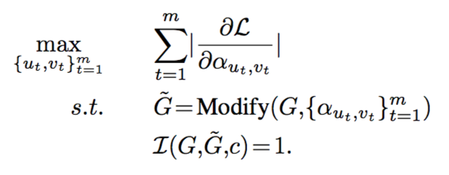
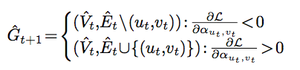
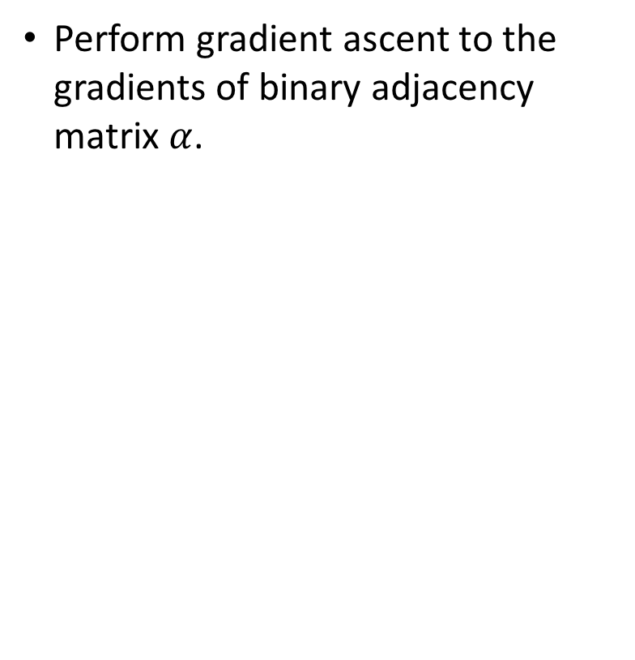
Gradient-based White Box Attack
Perform gradient ascent to the gradients of binary adjacency matrix $α$.

Slide 7
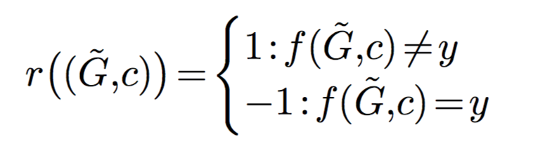
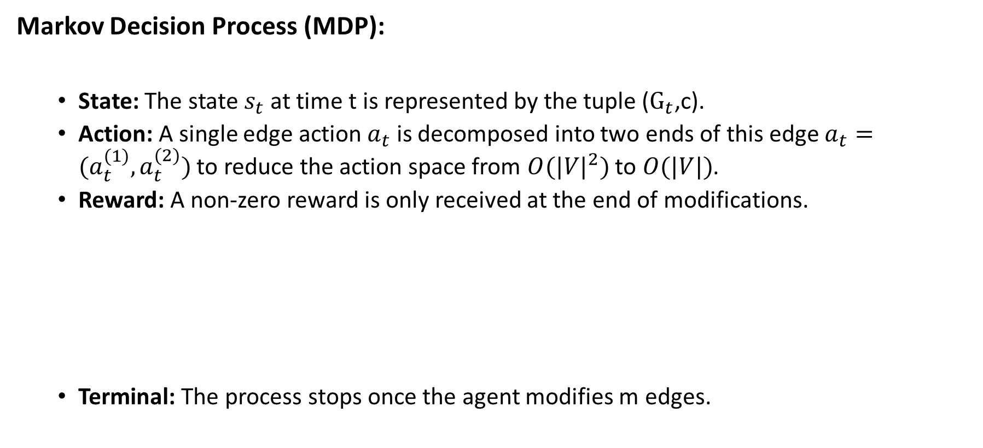
Attack as Hierarchical Reinforcement Learning
Markov Decision Process (MDP):
State: The state $s_{t}$ at time t is represented by the tuple ($G_{t}$,c).
Action: A single edge action $a_{t}$ is decomposed into two ends of this edge $a_{t}=(a_{t}^{\left(1\right)},a_{t}^{(2)})$ to reduce the action space from $O({|V|}^{2})$ to $O(|V|)$.
Reward: A non-zero reward is only received at the end of modifications.
Terminal: The process stops once the agent modifies m edges.

Slide 8
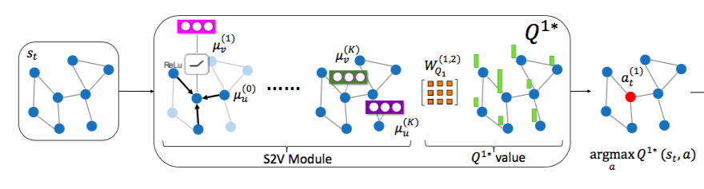
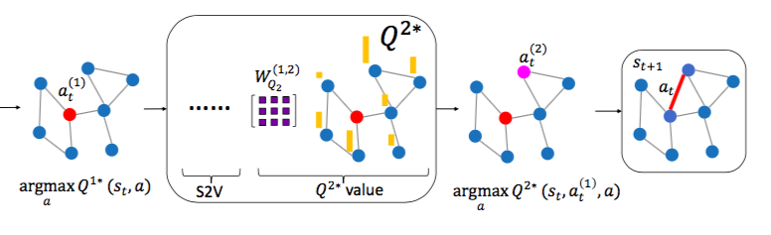
Attack Policy
Notes:
Q function is the expected reward following the policy

Slide 9
Q-learning
Node embeddings from structure2vec.
Representation of a state tuple

Slide 10
Genetic Algorithm
Population: random valid modifications to G.
Fitness: measured by the loss function.
Selection: weighted sampling or greedy.
Crossover: randomly pick two candidates and mix their edges.
Mutation: a certain probability to change each edge (u,v) to either (u,v’) or (u’,v)
Notes:
The key idea of a genetic algorithm is to maintain a set of candidate solutions -- which in this case are randomly perturbed adversarial graphs.
Each candidate solution - will get a fitness score that measures the quality of the solution – here measured by loss function -> higher loss => higher fitness score.
In each step, the candidates with the best fitness scores are chosen. Crossover – mixes the edges of selected candidates to create new graphs for the next step.
Mutation will change edges.

Slide 11
Experiments: graph-level attack
Dataset:
15,000 synthetically generated Erdos-Renyi random graphs. Divided into training set, test set I and test set Ⅱ(for RBA attack).
Classifier predicts the number of connected components in each graph.
Gold Standard Classifier: how many connected components (up to 3).
Target Model: structure2vec (message passing neural network).
Notes:
This paper considers two different problem settings – (1) semi-supervised node classification in a large graph where the goal is to classify nodes in the graph into K classes given a limited number of labeled examples. A typically setting is classifying research papers in citation networks.
(2) Graph classification – where the goal is classify a collection of small graphs into different categories. A common setting is protein

Slide 12
Experiments: graph-level attack
Notes:
S2v uses global mean pooling over all nodes in the graph – WBA is not effective since the same gradient is dispatched to all the nodes.

Slide 13
Experiments: node-level attack
Datasets: Benchmark citation networks.
Target Model: 2-layer GCN.
Budget: Delete single edge within 2-hops of target node c.
Graph Convolutional Network (GCN)

Slide 14
Experiments: node-level attack
Gradient-based WBA does quite well.
Lower attack effectiveness in black-box setting.
~10% performance decrease on single edge deletion attack.

Slide 15
Experiments: Simple Defense Strategy (Edge dropout)
Edge dropout during training for defense.
Attack rate decreases by 1%.

Slide 16
Experiments: Adversarial Graphs

Slide 17
Conclusions
GNN models can be quite vulnerable to adversarial attacks.
Single edge deletion can lead to 10% drop in model performance.
Simple defense strategies might help improve the robustness of graph neural models.
Limitations:
RL attack is not much better than a greedy gradient-based attack for node classification.
Explicit semantics/gold classifier is unrealistic. Need better graph graph similarity metrics.
Training an RL agent is computationally very expensive in practice and requires lots of data.
Need better automated mechanism to test the true label of an arbitrary graph/node.

Slide 18
Related Work – Adding fake nodes
Other attack models?
Non-targeted attack - lower the classification accuracy on all the existing nodes
Adding fake nodes [1].
Generate adjacency and feature matrices of fake nodes.
Two attack methods:
Greedy attack:
iteratively add one feature/edge at each step.
Greedy GAN:
discriminator to ensure fake features are similar to the original ones.
[1] Attack Graph Convolutional Networks by adding fake nodes - https://arxiv.org/pdf/1810.10751.pdf

Slide 19
Related Work – Meta-learning
Attack goal:
Non-targeted poisoning attack :
Reduce generalization performance of the model on the unlabeled nodes.
Meta-learning:
Usually optimizes the learning algorithm, e.g., by optimizing the hyper-parameters.
Poisoning attack Bi-level optimization:
Meta-gradients by treating graph structure as a hyper-parameter.
Greedy approach to tackle discrete data.
Not clear why it should be better than a greedy gradient attack.
[1] Adversarial attacks on graph neural networks via meta learning - https://openreview.net/pdf?id=Bylnx209YX

Slide 20
Questions
Why do you need a RL based attack when everything is supervised? Wouldn't something simple like imitation learning be able to attack the network quite robustly and not being expensive?
Instead of using unnoticeable perturbations, would it be better to use a kind of discriminator to discriminate between benign and attacked graphs
Good idea!
Is there an alternative way to restricting the number of malicious edges? Though 'number' is the most straightforward way to defining similarity, attack may change the true label of node/graph?
Discriminator again to preserve structural properties?
What’s the advantage of RL for attack model compared with other learning methods? Especially considering that it requires prediction labels from the target classifier.
Explore combinatorial search space.
Is there any practical adversarial attacks on a graph neural network? For example, can we use the technique mentioned in the paper to create spam accounts or propagate fake news?
Fake node addition may be possible but not directly from this methods.

